Slide 1
Faculty of Mathematics and Physics
Charles University
Introduction to Game User Experience
Lecture 1

Slide 2
Practical Informations
We will meet physically
Follow the current regulations
Stream of lectures
Notes:
Similar to basic features of the game we talked about last time – to master the form, you

Slide 3

Guest Lecturer
Asoc. Prof Barbaros Bostan
Bahcesehir University
Player types & motivations
3 guest lectures + consultations
Notes:
Similar to basic features of the game we talked about last time – to master the form, you

Slide 4
Shared Document
Let‘s go to the g-doc https://docs.google.com/spreadsheets/d/1S224KOCIWKzA_WloW1wx3kx8IBXlc33VQ1ihAeZIDoY/edit?usp=sharing
(Link in the Discord)

Slide 5
GUX Requirements
3 credits = 75 hours
Grade A 91 – 100 points
Grade B 81 – 90 points
Grade C 71 – 80 points
60 points is a minimum for a course credit Then, up to 40 points for the exam

Slide 6
Assignments
Small Assignmets 5 x 5 points
Large Assignments 2 x 15 points
Shared doc 12 x 1 points
Total of 67 points
Notes:
Usually reading + some quest
Tolerance – it is online instead of in the house, so it is kind of a harder
Two bigger ones - FMV slash adventure
Questions?
History of monopoly

Slide 7
GUX Near future
5. 10. – Requirements + what is GUR
12.10. – Case studies
19.10. – Player Psychology (BB)

Slide 8
GUX long-term view
Flow, engagement, motivation, bartle player types
Loss Aversion concept; UX Text and how to work with it
Methods and Tools for data collection in GUR
What can you do before, during and after release
Heuristic methods+ RITE model + onboarding tutorials,
Eyetracker; How can game move us (emotions; PANAS)
Player Profiling
Game Experience; In-game analytics; RVA analysis
Accessibility and Inclusivity

Slide 9
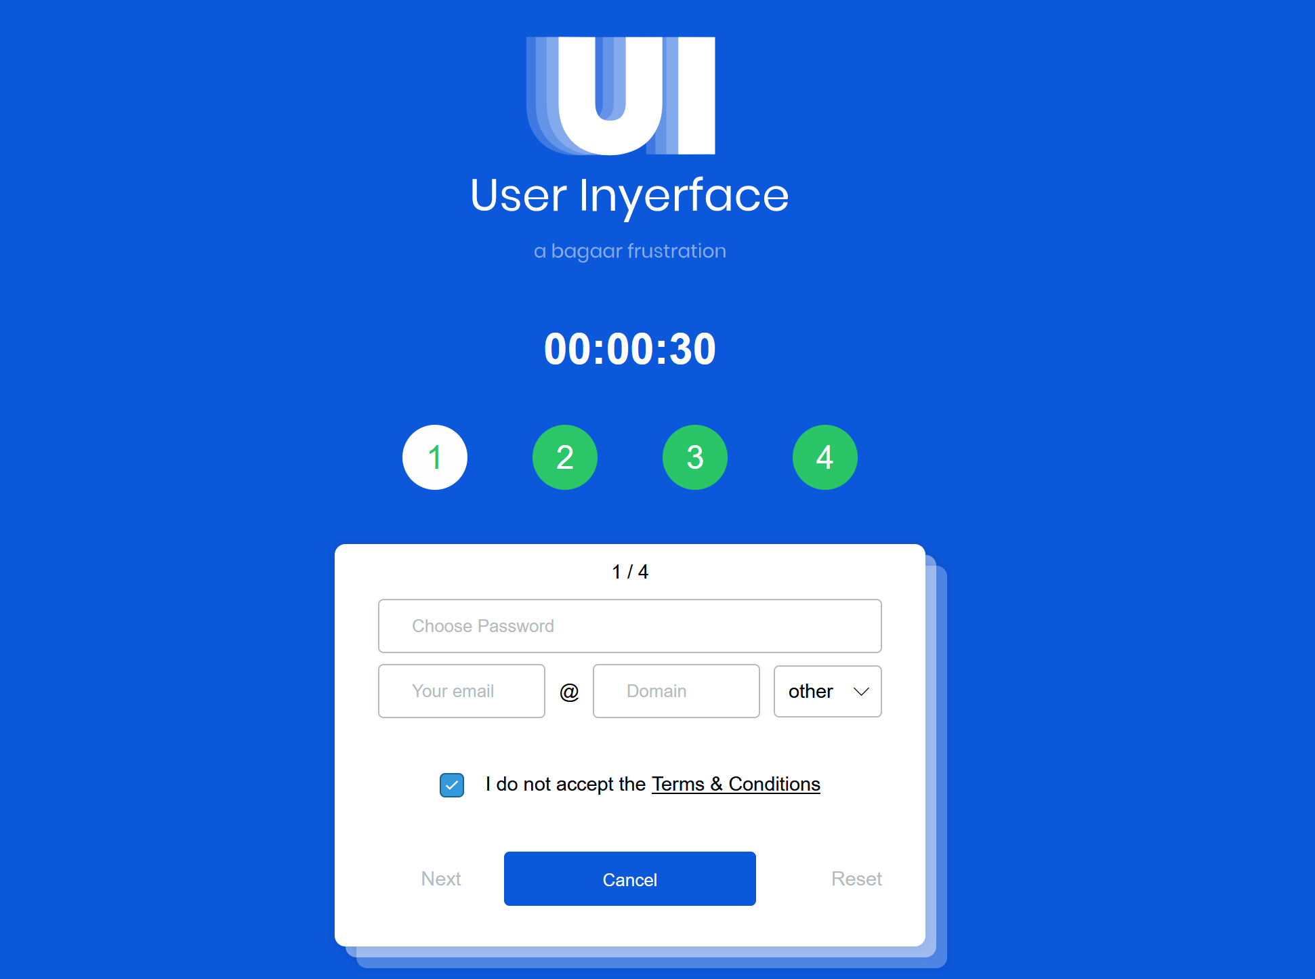
GUX long-term view
Notes:
https://userinyerface.com/game.html
https://projects.ics.forth.gr/hci/ua-games/game-over/downloads.html

Slide 10
What is GUR?
Multidisciplinary field
Optimal user experience and usability
Planned experience vs Actual experience
It is not a QA
Evidence-based

Slide 11

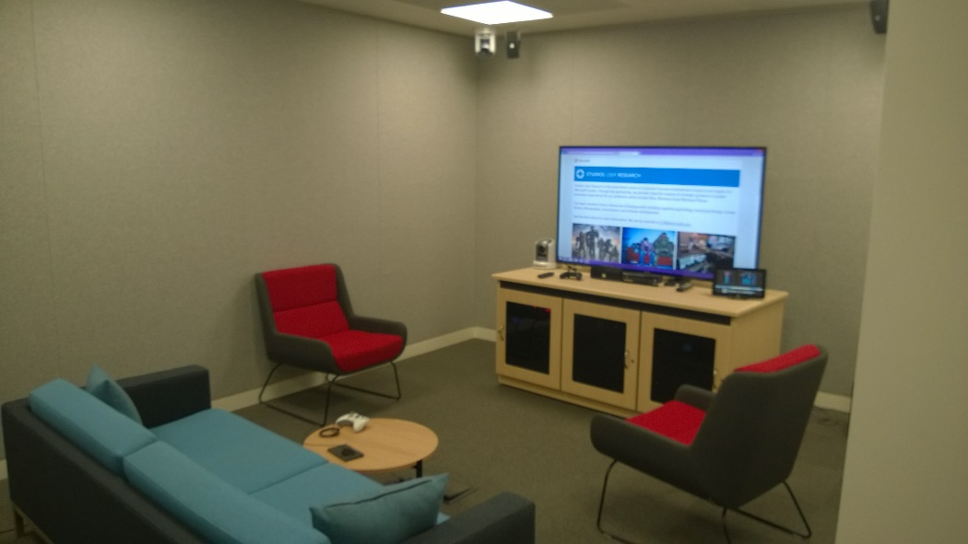
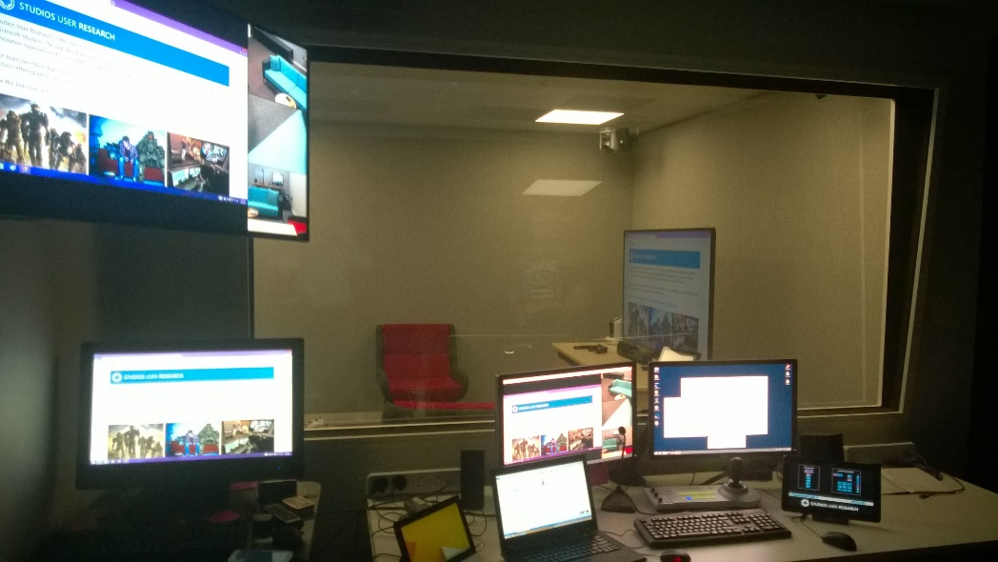
Gamedev & GUR
Player Research’s Montreal studio
(Source: playerresearch.com)
Microsoft Studios User Research
(Source: grux.org/)

Slide 12
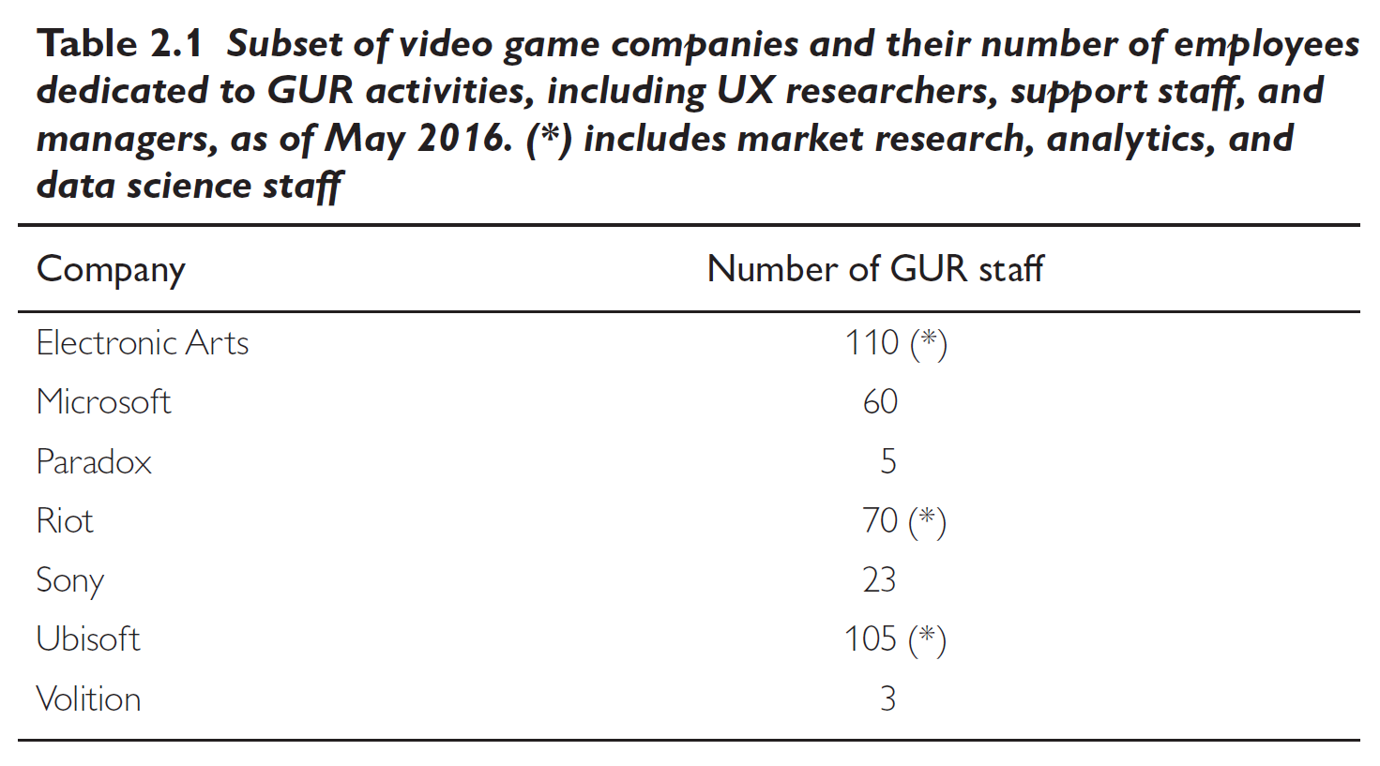
What is GUR?
Snowworld by Hoffman & Patterson
(2003)
Game User Research
(Drachen et al., 2018)

Slide 13


Different phases
1
Execution
2
Preparation
Analysis
4?
Reporting
3

Slide 14



Resources
Game User Research
(Drachen et al., 2018)
The Gamer‘s Brain
(Hodent, 2017)
The Video Game Debate 2
(Kowert & Quandt, 2020)

Slide 15
Shared Document
Let‘s go to the g-doc https://docs.google.com/spreadsheets/d/1S224KOCIWKzA_WloW1wx3kx8IBXlc33VQ1ihAeZIDoY/edit?usp=sharing
(Link in the Discord)

Slide 16
Summary
Player experience vs user experience
What is GUR?
QA vs GUR
GUR and video game companies
Typical phases of GUR

Slide 17
Faculty of Mathematics and Physics
Charles University
In case of questions:
kolek@ksvi.mff.cuni.cz
Stay in touch on Discord

